Slide 1
ITALIAN Second Language
code 30308 a.y. 2025-2026
Course Introduction

Slide 2

Course objectives
Reach a minimum B1 level of the Common European Framework
Consolidate the four communication skills: listening, writing, reading, speaking
Gain a greater understanding of using Italian in a professional context

Slide 3

Prerequisites
To successfully follow the course it is necessary to have at least a minimum of A2 level of Italian and in particular:
To attend the preparatory course lectures
If you do not have the required level it is strongly recommended to study:
- Lezione 0: catching up
- Altissia platform

Slide 4
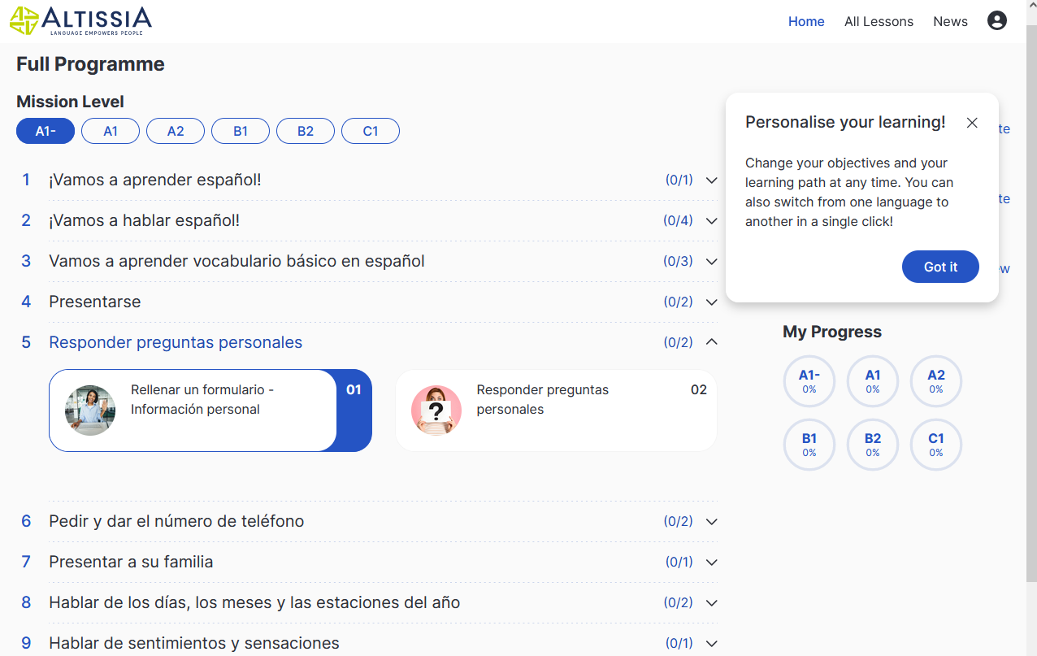
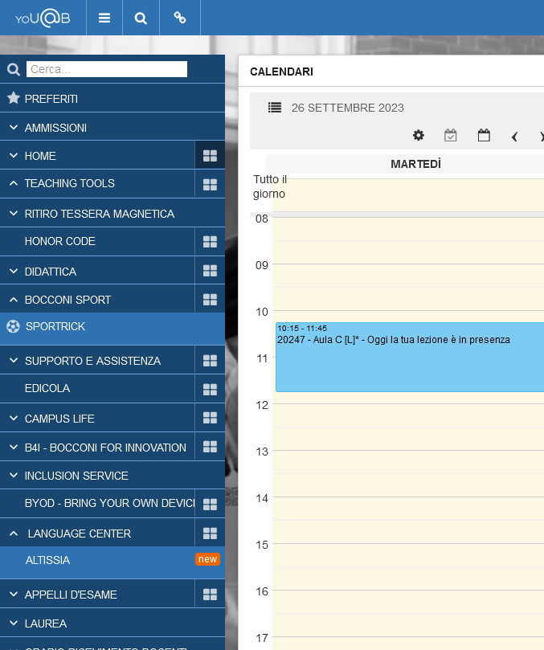
Altissia
Multimedia platform useful as a support of language studying
Access only through the yoU@B Diary
Available for English, French, Spanish, German, Italian and Portuguese
Personalized path based on your skills (for those students who do not have the required level to attend the curricular course please complete the paths to reach it)
Language skills Test (you can do it once a month)
A number of exercises, in the different paths and topics
«News» section with videos always updated

Slide 5

Course structure: 48 hours
Topics covered: travelling and tourism, leisure, family, environment, technology, working conditions, professional Italian, Made in Italy, fashion.
Focus on:
communicative ability (including through lexical and grammatical structures)
functional language
topic and task-based learning

Slide 6

Teaching methods
How do I learn?
Working independently at home on tasks and exercises
Taking advantage of the digital tools available
Working in the classroom through active participation in lessons

Slide 7

Course bibliography
Course book:
L’italiano all’università 1
Edilingua 2013 (For English Speakers)
ISBN: 978-960-693-124-6

Slide 8

Internal exam
Students can sit the general exam as from the end of second semester (from May)
5 exam sessions throughout the year (May-June, June-July, August-September, October, January-February)
Exam in presence aimed at evaluating four skills: reading, writing, listening and speaking, in line with international certifications
Grading: mark out of 30
To take the exam, registration is required via yoU@B Diary
For detailed information, check the course syllabus

Slide 9
Exam structure
Written part (listening, reading, writing): 90 minutes
Oral part (speaking): max 15 minutes
The written exam is the same for attending and non-attending students. It is digitalized and takes place on Campus from students’ laptop. Before taking the written part, students are required to verify well in advance that their technical equipment is working correctly
The oral part follows the written part, on the same day or the following day if the number of registered students is high (i.e. June). It includes different formats and contents for attending and non-attending students.

Slide 10
Oral part for attending students (75%)
1. Presenting a freely-chosen topic with Power Point
2. Discussion based on topics chosen by the examiner and related to the course program
Students must demonstrate the ability to understand and respond to questions, in line with the requirements of the CEFR descriptors

Slide 11
Oral part for non-attending students
1. Oral presentation on a topic chosen by the student, selected from the
folder “Oral exam for non attending students”. If these materials are not
prepared well in advance, the examination cannot be conducted
properly
2. Discussion of one or more readings and vocabulary selected by the
examiner from the same folder
3. Discussion based on topics chosen by the examiner and related to the
course program

Slide 12

Exam rules
To pass the exam, students must earn at least a total of 18 out of 30, and at least one point in each of the four skills (listening, reading, writing, speaking)
Students must demonstrate the ability to understand and respond to questions, in line with the requirements of the CEFR descriptors

Slide 13
Attendance registration
At the beginning of each lecture, you will be requested to register your attendance. This is very important for the organization and monitoring of teachings. Registration is under the responsibility of the student. You can check your records, in real time, through the yoU@B Diary
Students who attend 75% of classes are considered “attending students”, which entails a different format in the speaking part, compared to non-attending students (see Slide 11 and Syllabus)
To be considered attending students, it is not sufficient to be physically present in class; active and engaged participation in class activities is required, including taking part in pair or group work and completing the assigned exercises.”

Slide 14

Recognized certifications
As an alternative to the internal exam, it is possible to recognize a language certification out of those accepted by the Language Center
Requests can be submitted through the language certification recognition procedure available in the yoU@B Diary - “Language Center” widget
Detailed instructions, rules and conversion tables are available at unibocconi.eu/languagecenter > Language Certification Recognition

Slide 15

Advice
Attend and participate in the lectures
Complete the suggested tasks and exercises
Use the multimedia materials available

Slide 16
Info & contacts
Professor: alessandra.malabarba@unibocconi.it
Office hour calendar and booking: yoU@B Diary - “Faculty Office Hours” section
Language Center website: unibocconi.eu/languagecenter
For further information check the FAQs and contact the Language Center via the B in Touch (yoU@B Diary) procedure

